Slide 1
Karamoja Crop Productivity & Food Security Analysis

Slide 2
Why This Analysis Matters
Is Karamoja producing enough food for its population?
Which districts are underperforming?
Where should we invest?

Slide 3
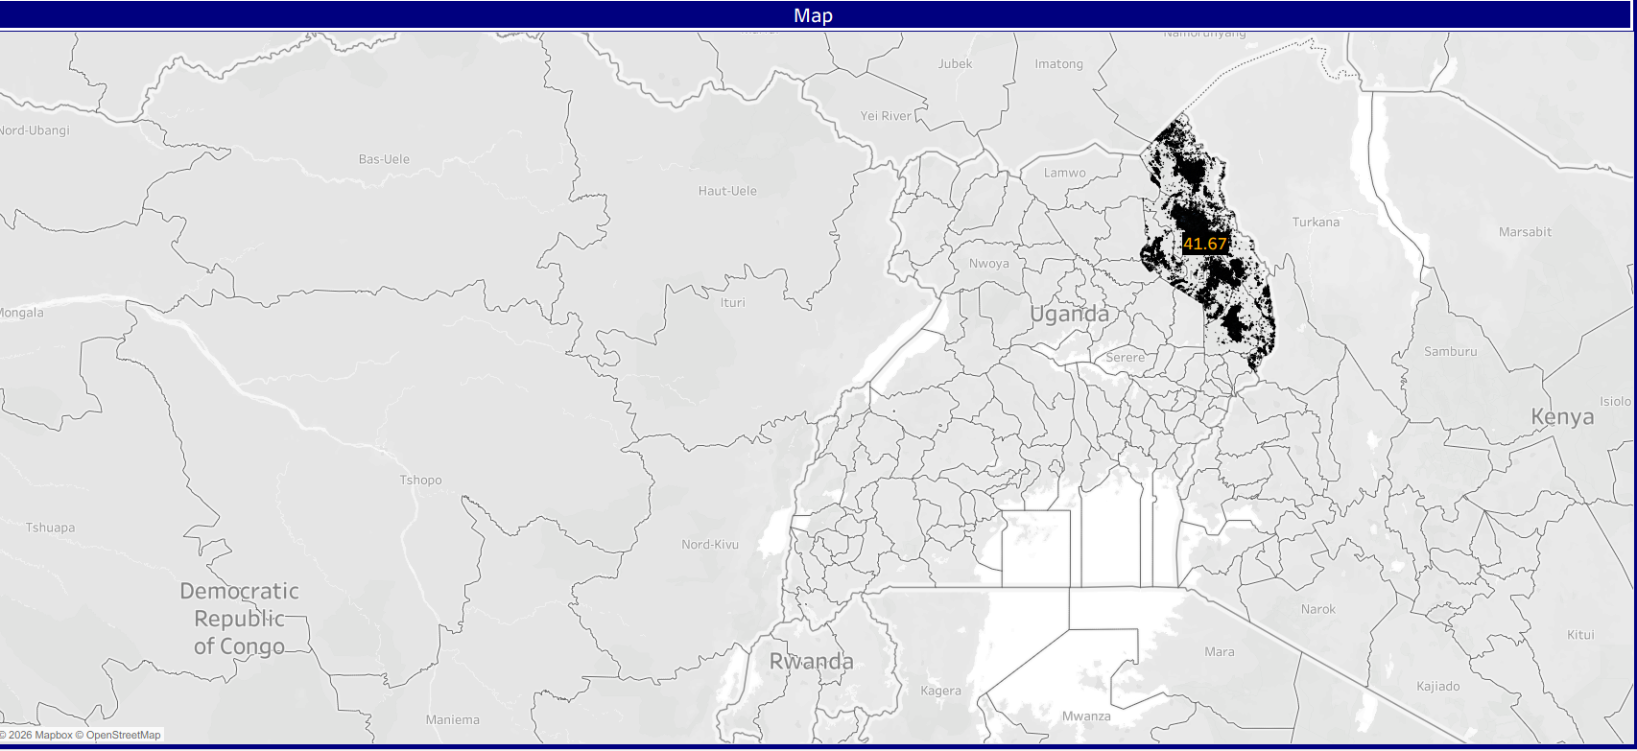
Overview of Karamoja’s Agricultural Landscape

Slide 4
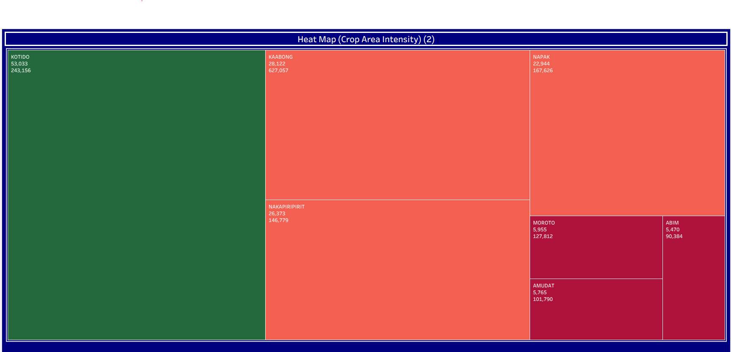
Food Security Intensity Across Karamoja
Green areas → High production per person
Red areas → At risk
Variation is significant

Slide 5
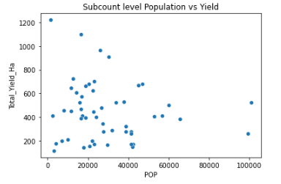
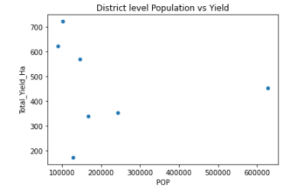
Population vs Yield
-Across both subcounty and district levels, population does not appear to strongly influence total yield per hectare. Productivity differences are likely driven by agricultural conditions, resource access, or management practices rather than population size.
-This suggests that increasing population alone will not necessarily improve production outcomes — targeted improvements in agricultural efficiency and inputs would likely have greater impact.

Slide 6
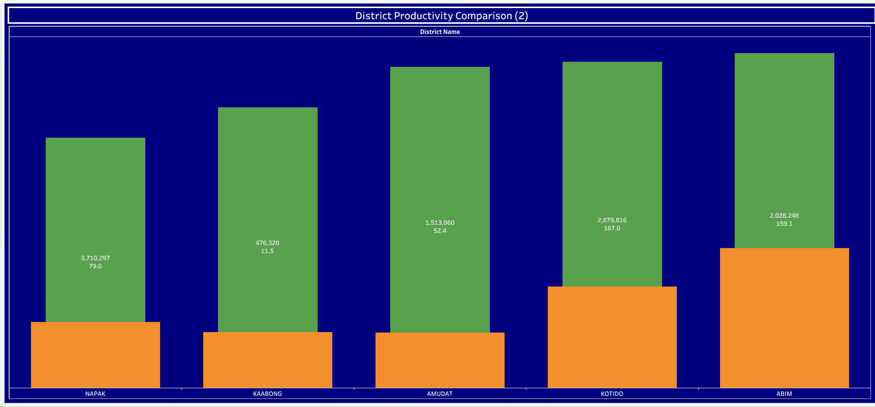
Maize vs Sorghum Performance
The 2017 Karamoja crop data shows a clear imbalance between productivity, land allocation, and food demand. Although maize yields are nearly four times higher per hectare than sorghum, most agricultural land is allocated to sorghum, likely due to its drought tolerance and lower climate risk.
Production levels vary significantly across districts, indicating that output is concentrated in a few areas, which increases vulnerability to localized shocks. At the same time, population distribution is highly uneven, meaning food demand pressure differs substantially by district.

Slide 7
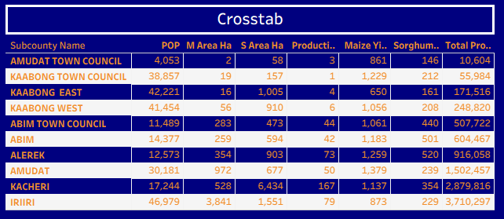
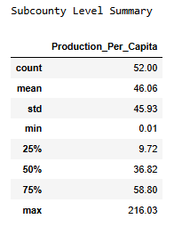
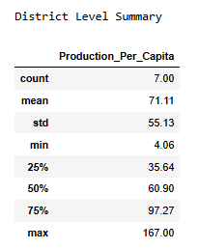
Dynamic Review
There is a substantial inequality in production per capita, particularly at the subcounty level. While the average production per capita is 46.06 at subcounty level, the very high standard deviation (45.93) and wide range (0.01 to 216.03) indicate extreme disparities
—some sub counties produce almost nothing per person, while others produce over four times the average. This suggests strong local imbalances in productivity or population distribution.

Slide 8
Business Recommendations & Future Opportunities
Key Findings
Maize yield is statistically higher than sorghum (based on the describe function on the subcounty level).
Population density shows negative correlation with yield.
Business Recommendations
Expand maize selectively in suitable zones- Scale high-performing crops strategically.
Maintain sorghum in drought-prone districts
Prioritize high-population districts for intervention- Prioritize high-risk sub counties for agricultural inputs.
Diversify crop allocation to reduce systemic vulnerability- Promote crop diversification in over-reliant areas.
Future Work
Integrate rainfall and soil data
Include multi-year yield comparison
Develop predictive yield models
Incorporate satellite vegetation index

Slide 9
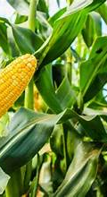
Thank you
Denis Mwilaria
0726359802
Denis.mwilaria2@moringaschool.com

